Slide 1


Classification of World Countries according to Civil Aviation Capacities (CAEM)
To determine the need of each member country in the ICAO technical support.
Notes:
Present myself.
“according to” !!!!!!

Slide 2
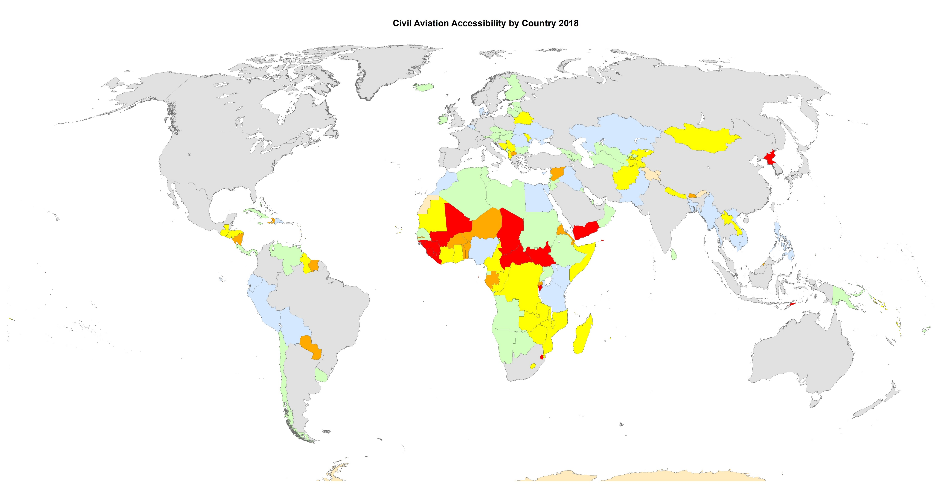
A – Very Low

Slide 3
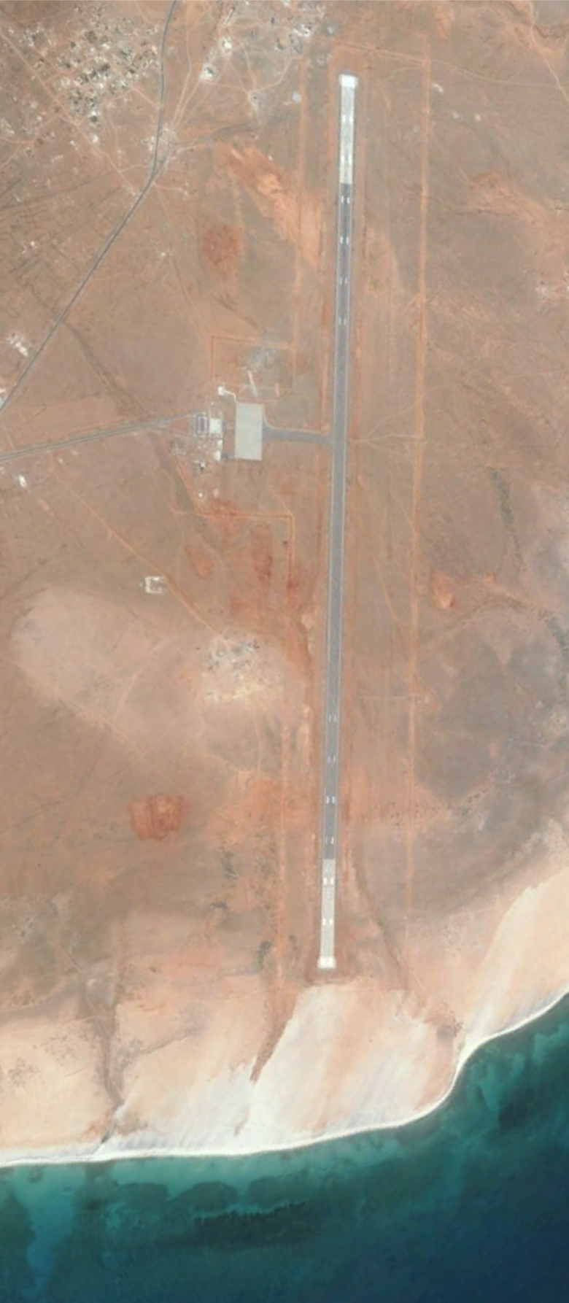
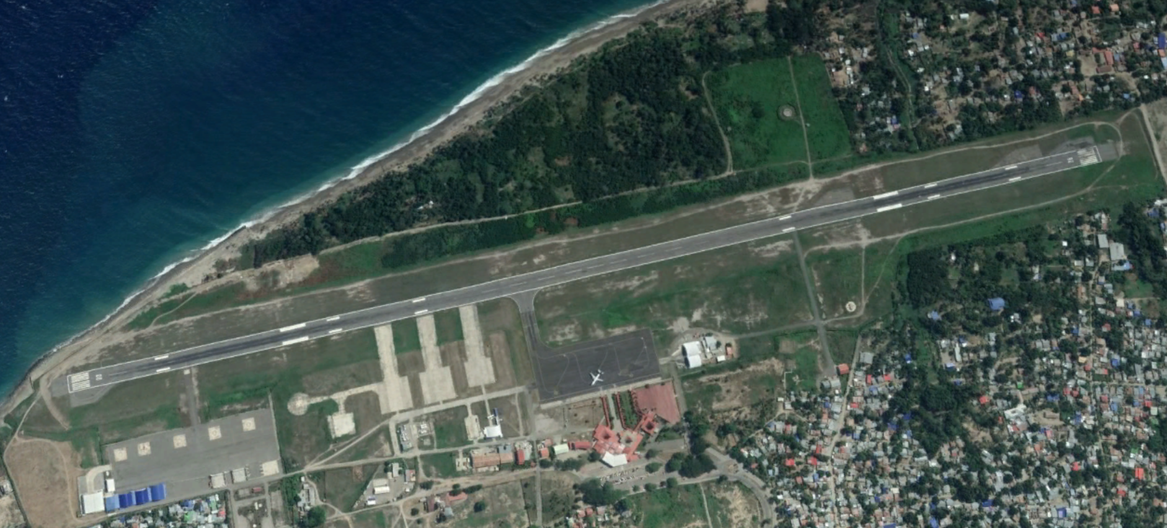
A – Very Low (20, 10.5%)
No big airports and less than 5,000 flights per years in the whole country.
Mainly Sub-Saharan African Countries with a low income.
More likely to need any technical support from the ICAO.
Yemen with Socotra INTL Airport
Timor-Leste with Dili INTL Airport

Slide 4
B – Low

Slide 5
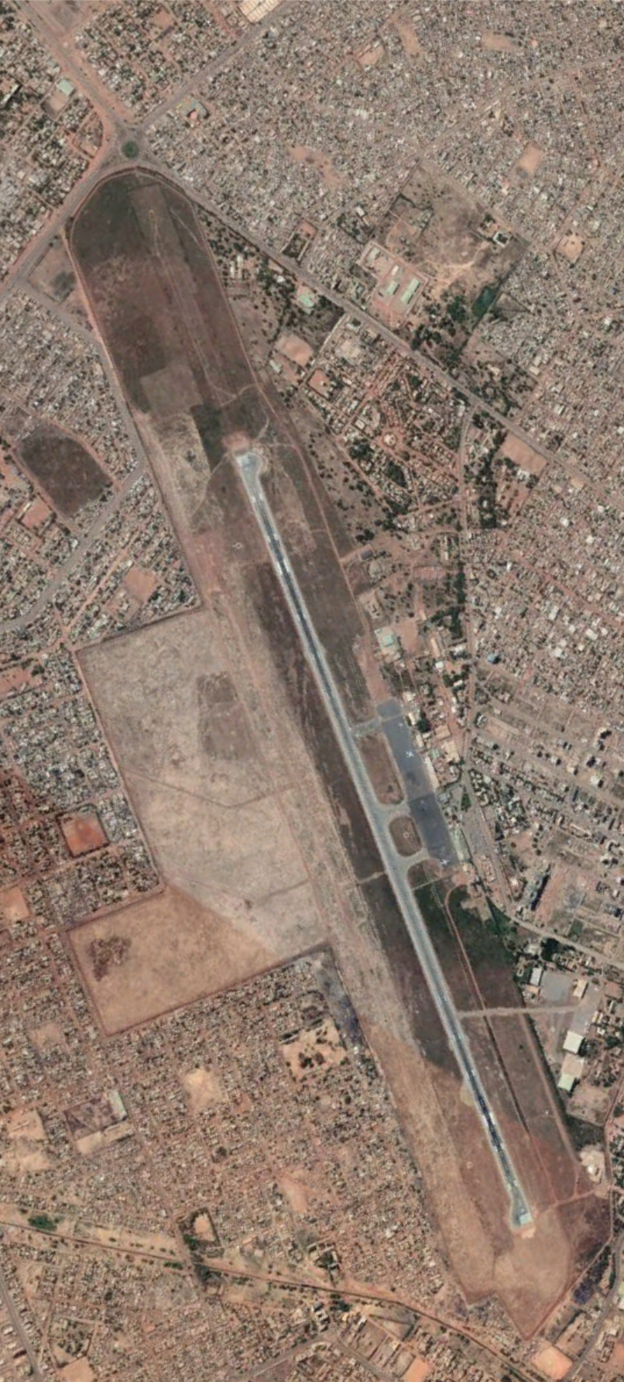

B – Low (21, 11%)
No big airports and a flight traffic about an average airport.
Better distributed around the world with three high income countries.
Prone to need the ICAO technical support.
Bhutan with Yongphulla Airport
Burkina Faso with Ouagadougou INTL Airport

Slide 6
C – Lower Middle

Slide 7
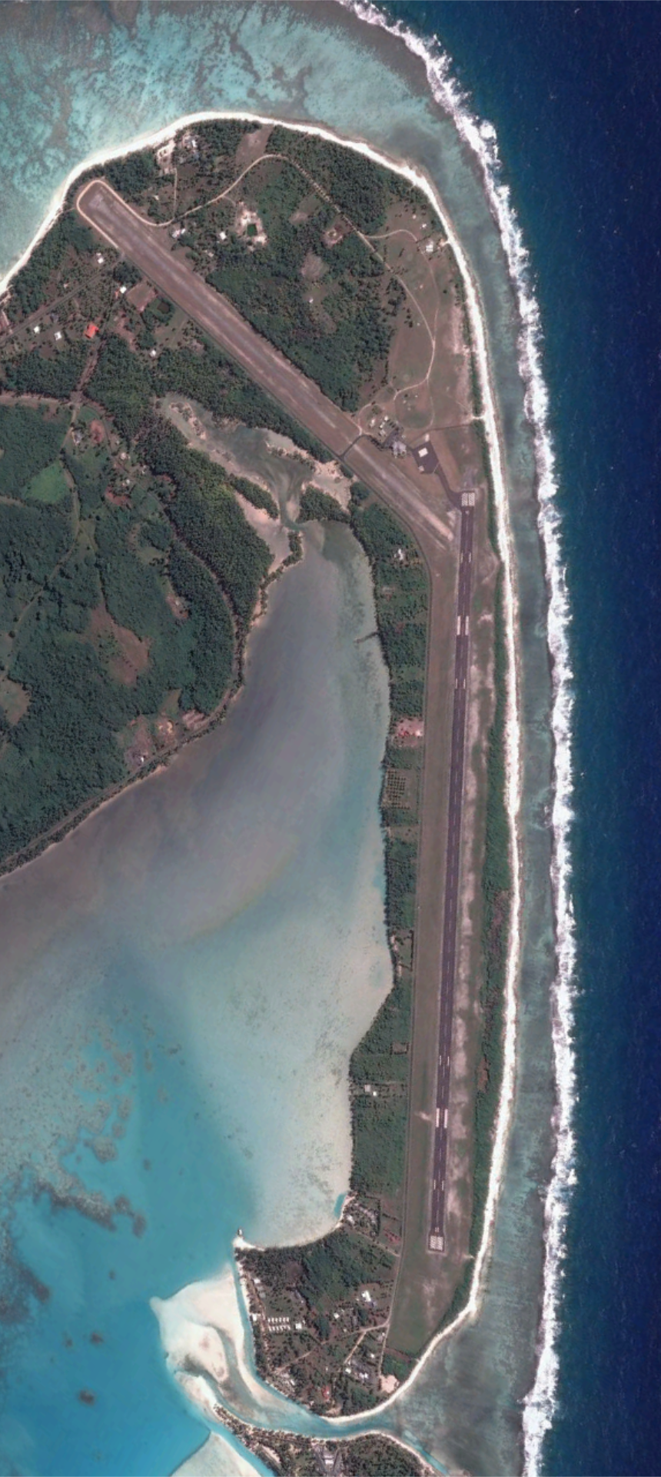

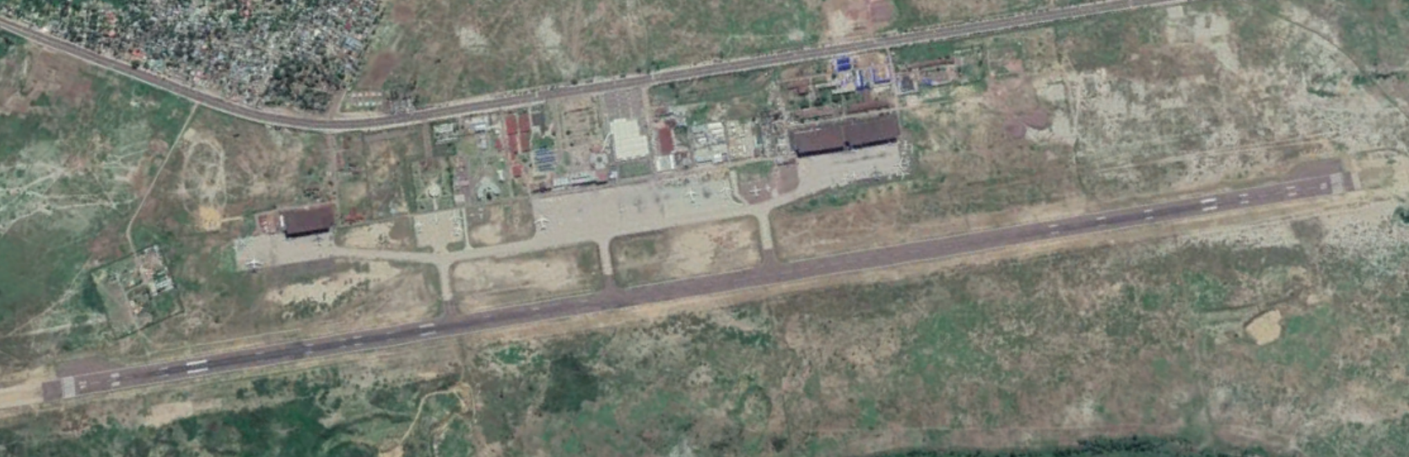
C – Lower Middle (38, 19.9%)
More than 10,000 flights per year in mostly small or average airports.
The rest of Sub-Saharan African countries and small-size countries in every continent.
Low-priority user of the ICAO technical support.
Cook Islands with Aitutaki Airport
DRC with Kinshasa INTL Airport

